Slide 1

PRESENTATION AND REFERENCES

Slide 2

INDEX
q GENERAL INFORMATION
q RESOURCES AND MEANS
q ORGANISATION
q SUSTAINABLE ENTERPRISE
q AREAS OF ACTIVITY
q REFERENCES
q MAIN CLIENTS
q CERTIFICATIONS: ISO 9001 / ISO 14001 / ENERGY AUDITOR
q CONTACT

Slide 3

GENERAL INFORMATION
Engineering services company
Efficient solutions for the development of gas installation projects in the Oil & Gas sector.
Company name: Estudios Ingeniería Energética 2020, S.L. (ESINEN)
Date of incorporation: 30 June 2016
CIF: B-74411927
General Manager: José González Cores

Slide 4

Resources and means (i)
We have an experienced team, which supports us in providing quality and
exclusivity in all our work.
Our central office is located in Meres (Siero-Asturias), where we have a
full set of IT tools to develop any type of project.
Project.
We also have the capacity to travel to the Client's offices both at
nationally and internationally.

Slide 5

Resources and means (ii)
Equipment available:
- 1 Chief Project Engineer
- 2 Mechanical engineers
- 1 Electrical engineers
- 1 Instrumentation engineer
- 2 draughtsmen
We also work with various companies and specialists in
continued collaboration with ESINEN

Slide 6

Resources and means (iii)
ADDED VALUE:
- Knowledge
- Agility
- Competitive prices
- Quality service
- Decentralisation of suppliers
- Agreements with partners

Slide 7
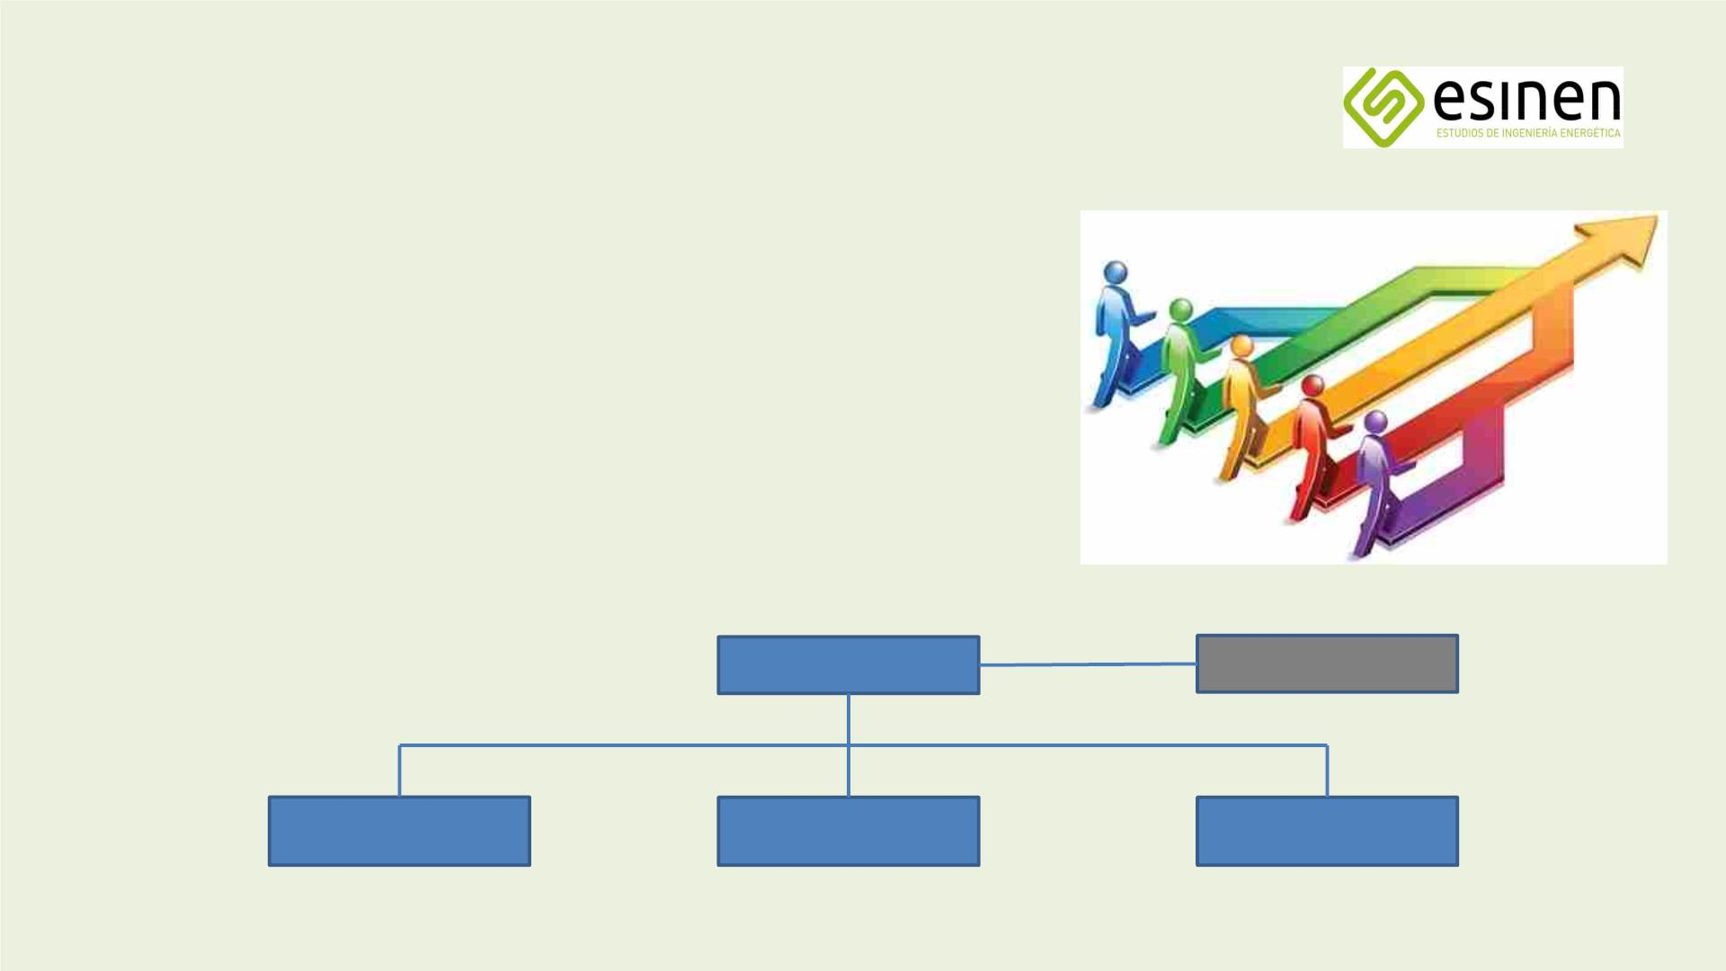
Organisation
Project Management
- Project Manager
- Mechanical engineers
- Electrical & instrumentation engineers
- Draughtsmen and draughtswomen
Project Manager
Draughtsmen
Engineers
mechanics
Engineers
electrical
Engineers
instrumentation

Slide 8

Sustainable enterprise
- Use of LED lighting
- Use of public transport by employees
- Reduced use of heating
- No use of air conditioning
- Use of environmentally friendly fuels
- Control of energy consumption
- Reduction of paper use
- Use of sustainable materials
- Reducing the use of plastic packaging and materials
- Waste separation and recycling
- Promotion and aid to employees for the purchase of electric and/or natural gas vehicles.

Slide 9

AREAS OF ACTIVITY
- Industrial Projects: Conceptual Engineering, Basic Engineering, FEED and Detail Engineering
- Specialised in Natural Gas, LNG, LPG and H2 projects.
- Supervision of Fabrication, Works and Commissioning
- Consultancy and Technical Reports
- Energy Audit

Slide 10

Industrial projects
ESINEN has the ability and experience to undertake the following
industrial scopes and projects:
- LNG Regasification Plants
- Hydrogen application projects
- Gas pipelines, ERMs, EMs
- LNG small scale / bunkering plants
- CNG/LNG filling stations
- Fire-fighting systems

Slide 11

Supervision of works PMC/EPCM
- Supervision of equipment manufacturing
- On-site supervision of the execution
- Supervision of the pre-commissioner and commissioner
- Start-up assistance
- Follow-up of planning
- Periodic on-site monitoring reports
- Economic monitoring and budgetary control

Slide 12

Consultancy and technical reports
- Any gas-related activity: LNG, NG, LPGs, H2
- Flowchart and process analysis
- Energy recovery studies
- Procedural analysis (procedures, specifications, etc.)
- Measuring systems: custody transfer
- Safety studies: HAZOP, SIL
- Project feasibility studies: CAPEX and OPEX
- Environmental impact analysis

Slide 13
HAZOP and SIL studies
-HAZOP:
-METHODOLOGY: DEVIATIONS IN OPERATION / CAUSES / EFFECTS / SCENARIOS
-PROCESS ANALYSIS
-DEVELOPMENT OF NODE CARDS
-CORRECTIVE ACTION
-ESTUDIO SIL:
-METHODOLOGY: CAUSE / EFFECT MATRIX
-PROTECTIVE COATINGS / SAFEGUARDS
-RISKGRAPH
-ASSIGNMENT FICHES SIL

Slide 14

Energy audit
- Energy audit: an inspection and assessment procedure applicable to any type of energy
installation or process, which improves energy efficiency and reduces energy bills, and
emissions.
- Royal Decree 56/2016 of 12 February establishes the obligation to carry out an audit.
Energy audit of companies by November 2016, with the audit to be repeated every two years.
four years.
- The audit is carried out in 6 phases: preliminary contact, initial meeting, data collection,
fieldwork, report, final meeting.

Slide 15
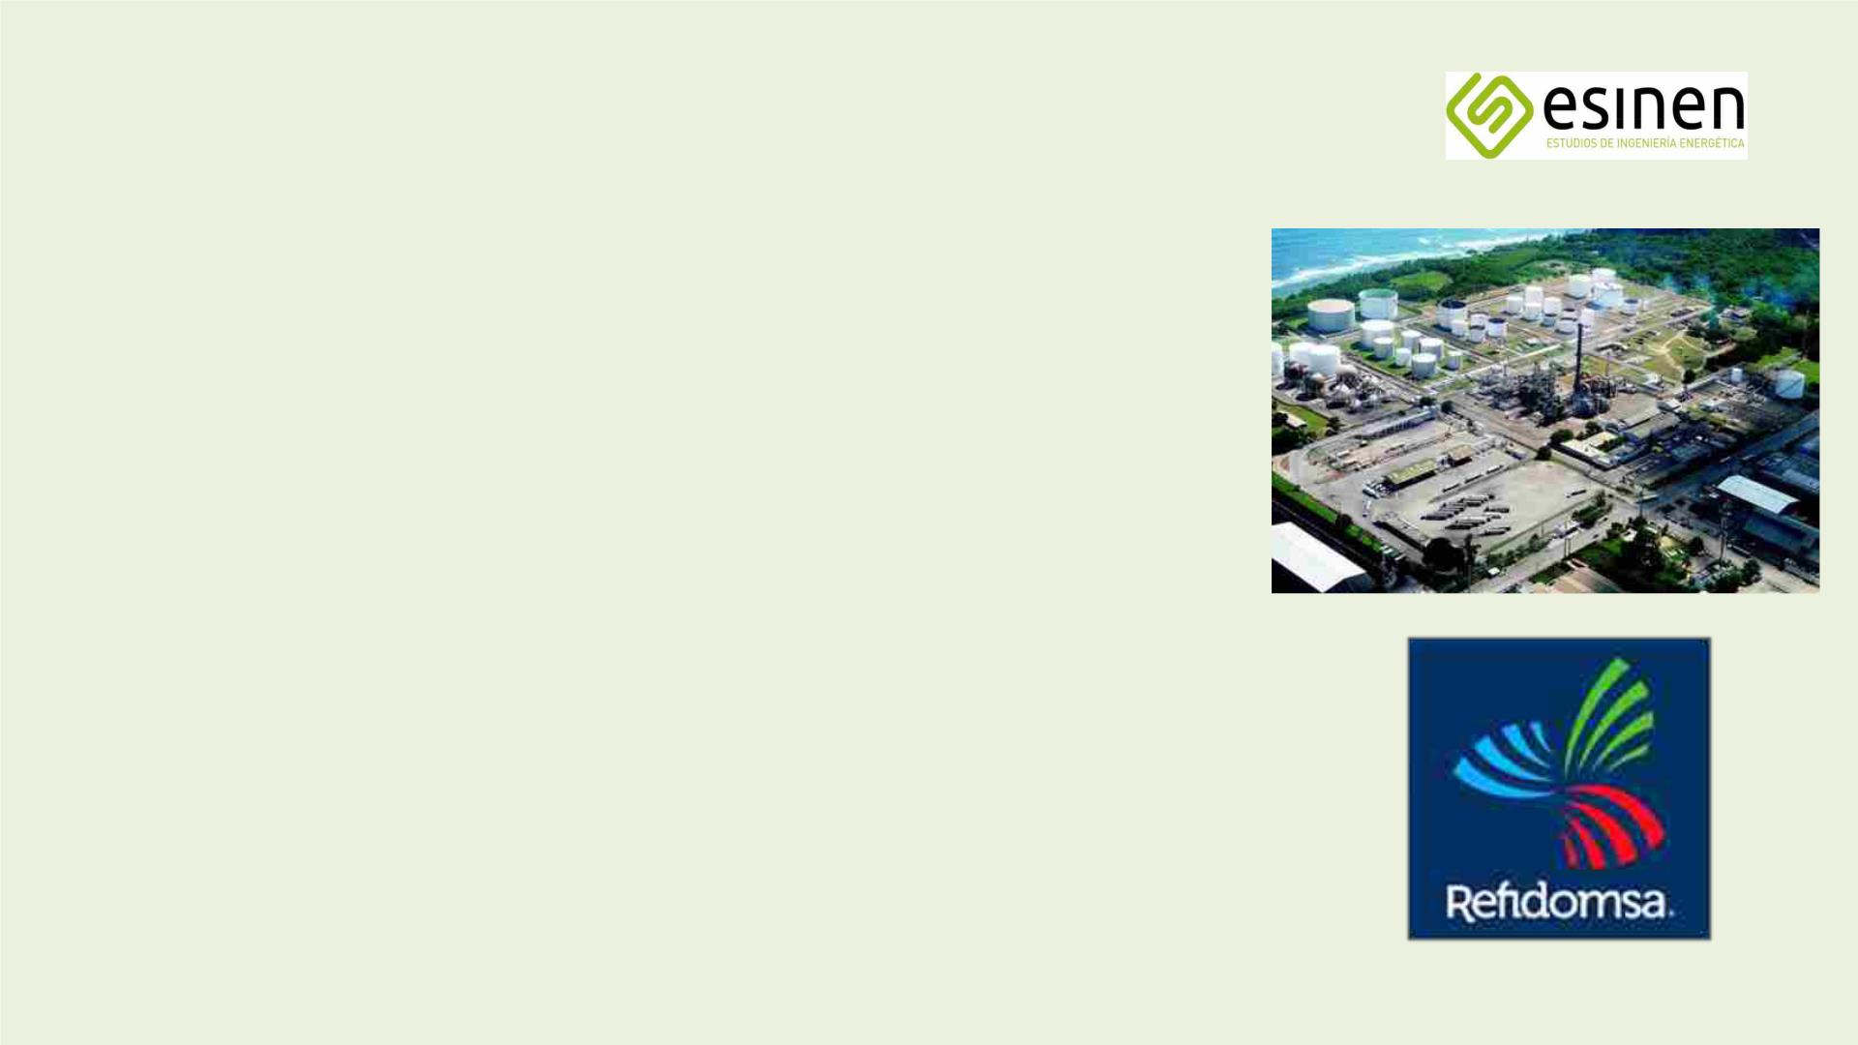
2016-2017
References (i)
REFIDOMSA REFINERY (DOMINICAN REPUBLIC)
- FEED engineering, LPG storage expansion.
- STORAGE options: pressurised, semi-pressurised, semi-solidified, semi-solidified, refrigerated, refrigerated.
- Option selected by the Customer: storage in spheres pressurised (4 x 10.000 m3)
- HAZOP and SIL of the 3 process options

Slide 16

2017
References (ii)
CONCEPTUAL ENGINEERING IMPROVED NATURAL GAS METERING SYSTEMS
- Study of metering system alternatives for the gas pipeline network associated with the
regasification of LNG from Reganosa's LNG Terminal in Mugardos
- Technology selection matrix
- CAPEX per alternative
- Project Built and in Operation

Slide 17

2017-2018
References (iii)
BASIC ENGINEERING AND FEED MEASURE UPGRADE OF GAS PIPELINE POSITIONS
- Administrative and environmental project
- Basic engineering positions ERM/EM high pressure B
- Preliminary Detailed Engineering (FEED)
- CAPEX/OPEX analysis.
- HAZOP and SIL studies

Slide 18

2017-2018
References (iv)
PROPOSED LPG STORAGE PARK 16.000 M3
- Basic and detailed engineering
- Electro-mechanical assembly
- Pre-commissioner and commissioner

Slide 19

2017-2018
References (v)
ENGINEERING FEED PROJECT INSTALLATION OF BOG HIGH PRESSURE COMPRESSOR (BOIL OFF GAS)
- Development of Preliminary Detailed Engineering (FEED)
- Administrative project
- Analysis and review of Basic Engineering
- ERM: 3rd measurement line extension
- HAZOP and SIL study
- Currently out to tender for construction

Slide 20

2018-2019
References (vi)
ELECTRICAL INSTALLATION AND INSTRUMENTATION STORAGE PARK
GASOLINAS_TERMINAL BAHÍA LAS MINAS_PANAMÁ
- Basic and detailed engineering
- EI&C supply and assembly
- Tank gauging system
- Pre-commissioner and commissioner

Slide 21

2018-2019
References (vii)
PRELIMINARY LAY OUT DESIGN OF SMALL SCALE GNL PLANT
- LNG flat bottom tank 40.000 m3
- Calculation of the generated boil off gas (static and dynamic study)
- General layout of the LNG plant
- Pipe rack sizing
- Jetty sizing
- Safety distances
- Project foreseen to be installed in Algeciras and finally not implemented
(The photo corresponds to a 30,000 m3 Flat Bottom tank built in Pori Finland)

Slide 22

2020
References (viii)
BASIC ENGINEERING LNG PLANT
Jovellanos Security Centre (Veranes_Gijón)
-LNG storage plant project

Slide 23

2019-2020
References (ix)
DETAILED ENGINEERING METER REPLACEMENT METERING STATIONS
- General coordination of the project
- Gas pipeline and ERM high pressure B (80 bar)
- Supervision of implementation
- HAZOP and SIL studies

Slide 24

2020
References (x)
CONCEPTUAL ENGINEERING HYDROGEN PRODUCTION
- Study of alternatives
- Capex and Opex
- Hazid Studio

Slide 25

2020
References (xi)
BASIC ENGINEERING FUEL SWITCHING AND RETROFITTING TO NATURAL GAS
Jovellanos Security Centre (Veranes_Gijón)
- Identification of the pipeline for direct NG supply to the Centre
- Natural gas reception installation project

Slide 26

2019-2021
References (xii)
FEED ENGINEERING REVIEW
- LNG bunkering plant
- 4 bulett tanks x 1.000 m3

Slide 27

2020
References (xiii)
BASIC POWER TO GREEN HYDROGEN ACTIVITY PROJECT.
ELECTROLYSIS PLANT INTEGRATED WITH A PHOTOVOLTAIC PARK
- PEM technology
- For use in fertilisers

Slide 28
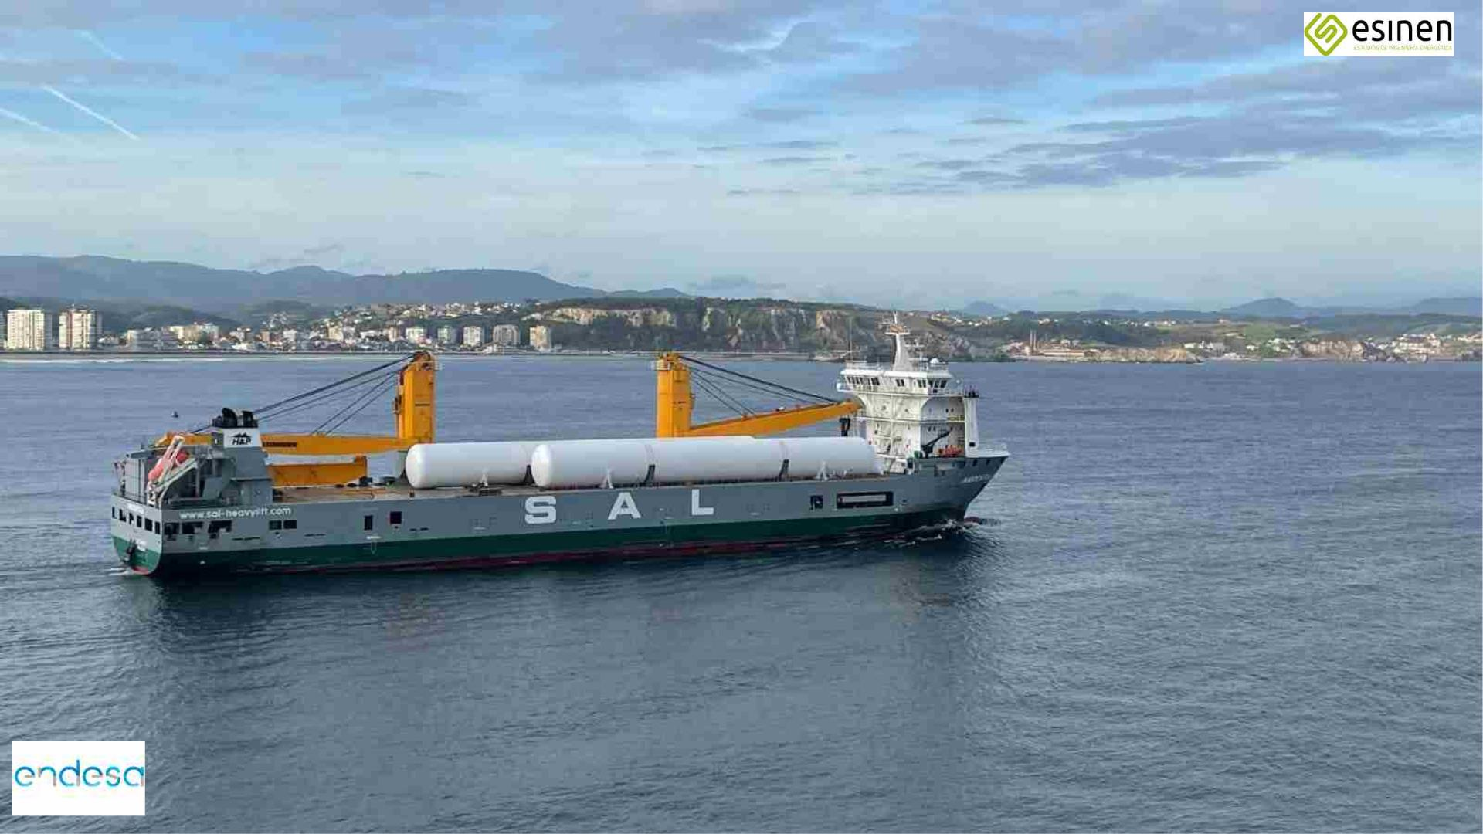
2022-2023
RECENT REFERENCES IN GNL (1)
LNG STORAGE PLANT OF
UP TO 10,000 M3
- Inspection of the manufacture of the 1000 m3 LNG tanks
- Complete process monitoring, from specification and
materials collection, manufacturing and delivery to the final customer. ENDESA, at the Los Barrios Port Terminal (Cadiz).
- Date of entry into operation: September 2023

Slide 29
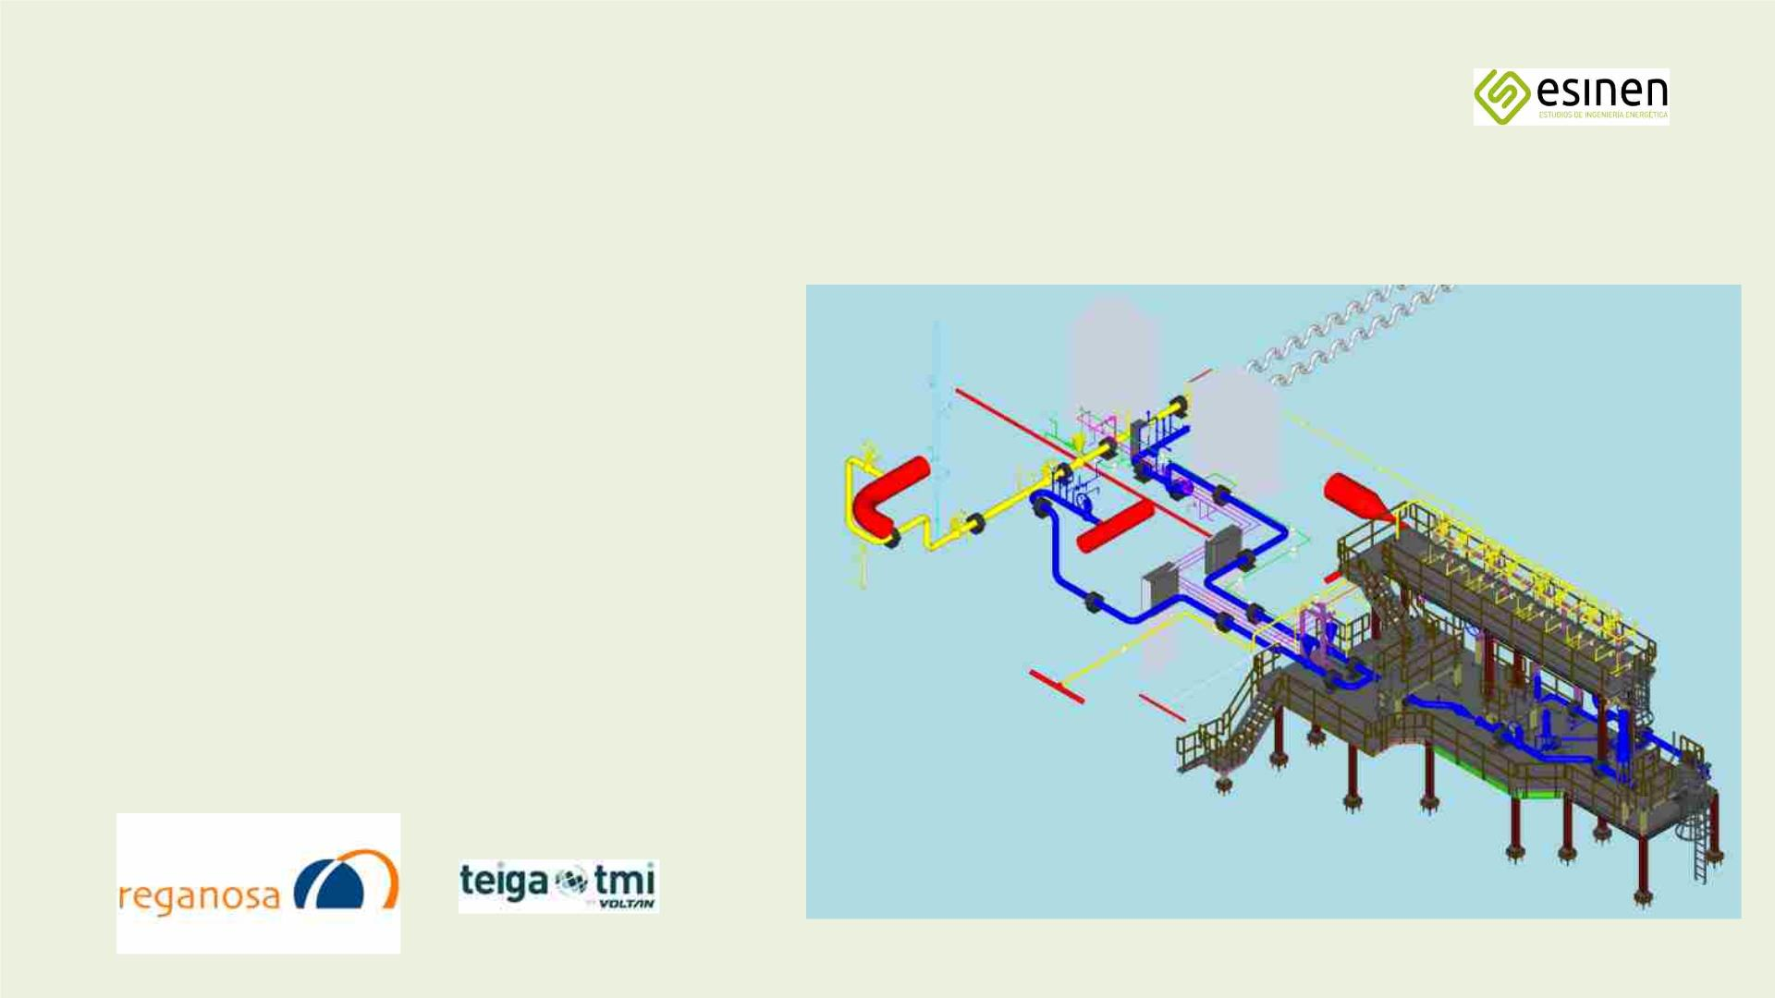
2022-2023
RECENT REFERENCES IN GNL (2)
ADAPTATION OF THE JETTY OF THE MUGARDOS LNG TERMINAL FOR OPERATIONS
SMALL SCALE
- General coordination of the project
- Carrying out detailed engineering
- Supervision of Implementation
- Commissioning Supervision
- Commissioning date: May 2023

Slide 30
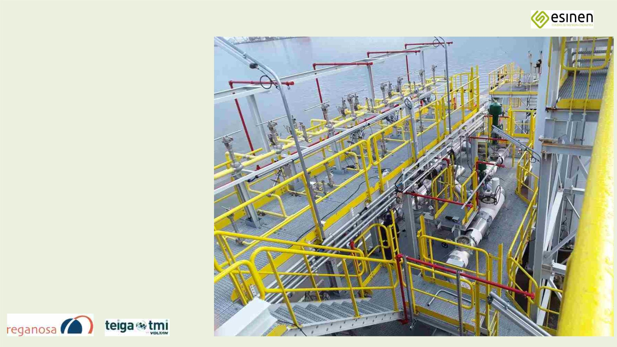
2022-2023
RECENT REFERENCES IN LNG (2a)
ADAPTATION OF THE TERMINAL JETTY
OF GNL OF MUGARDOS FOR THE
OPERATIONS WITH SMALL VESSELS
SCALE (BUNKERING)
- General coordination of the project
- Carrying out detailed engineering
- Supervision of Implementation
- Commissioning Supervision
- Commissioning date: May 2023

Slide 31
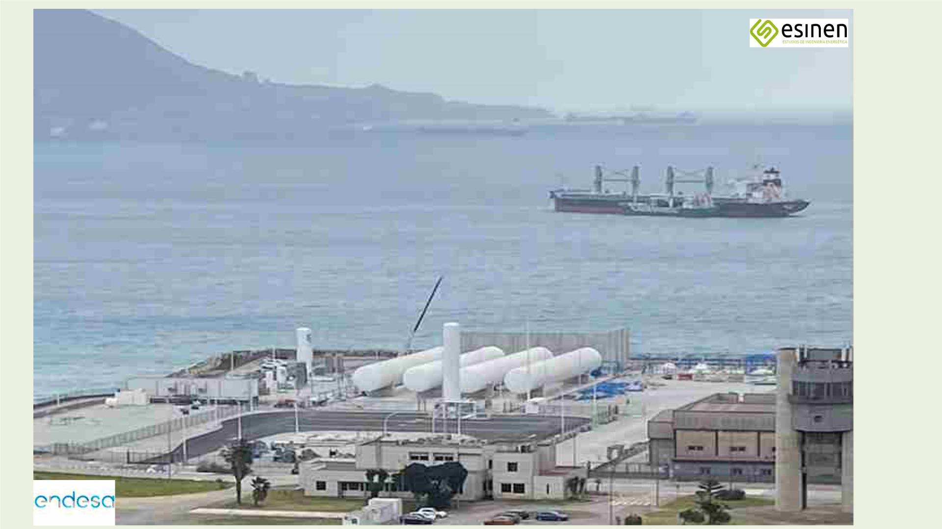
2022-2023
RECENT REFERENCES IN GNL (3)
Technical Assistance and Supervision of the
Commissioning for the
LNG that ENDESA is building
at the Los Angeles Port Terminal
Barrios (Cádiz).

Slide 32
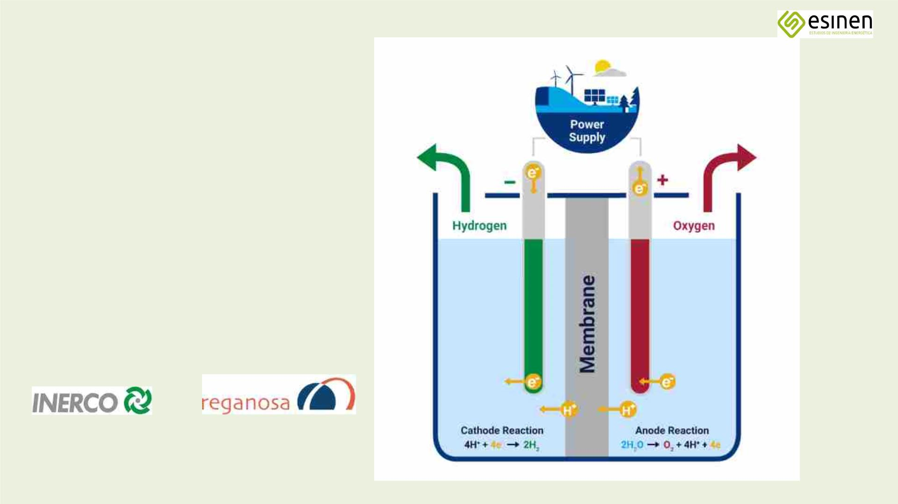
RECENT REFERENCES IN H2 (4)
2022-2023
PIPING SPECIFICATION FOR
HYDROGEN PRODUCTION 50+50 MW
- Green hydrogen from electricity
generated in wind farm
- Electrolysis by PEM technology
- Injection into APB pipeline

Slide 33
EPILOGUE I
- We are a company SPECIALISED in LNG, NG, LPG and H2
- All our technicians have more than 25 years of experience in the Oil&Gas sector.
- We offer proven experience, agility, competitive prices and commitment.
- We are a small company but our value is specialised KNOWLEDGE.
- We offer Technical advice, Feasibility studies, Studies of alternatives and optimisation, Conceptual, Basic and Detailed Engineering Projects, Construction Supervision and Start-up assistance. Consultancy and technical advice on LNG, NG and LPG.
- We only carry out EPCs in joint ventures with partner companies (UTEs with Costructor).

Slide 34
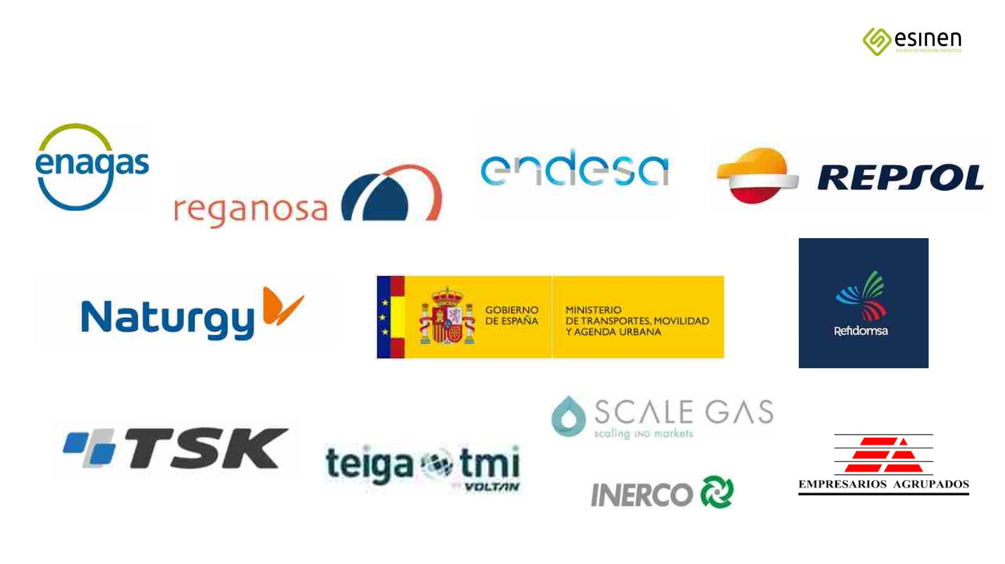
MAIN CUSTOMERS

Slide 35
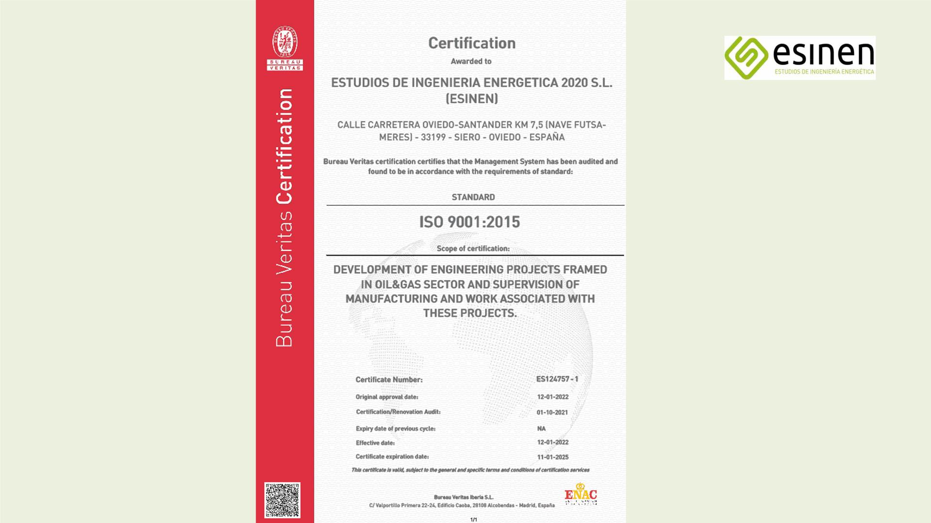
ISO 9001

Slide 36
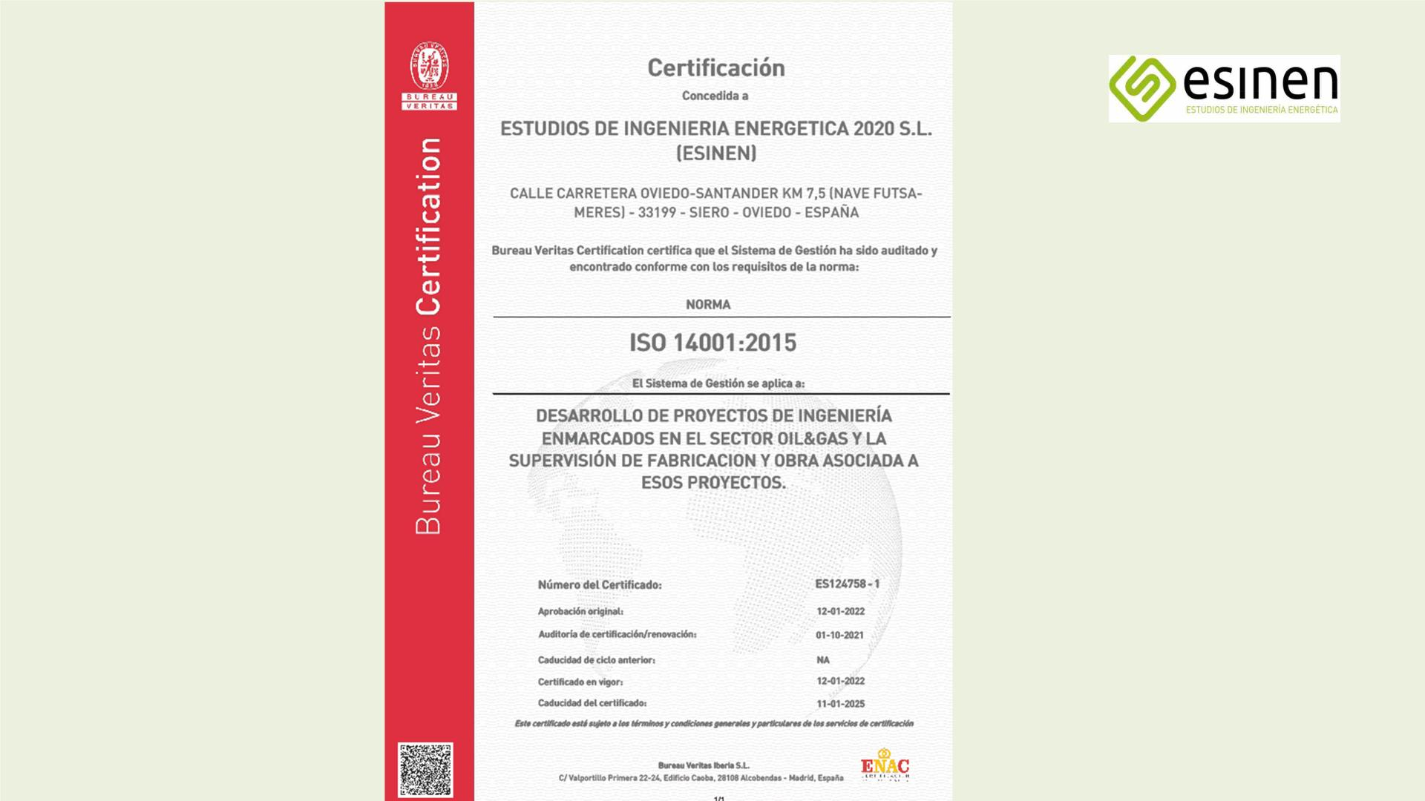
ISO 14001

Slide 37
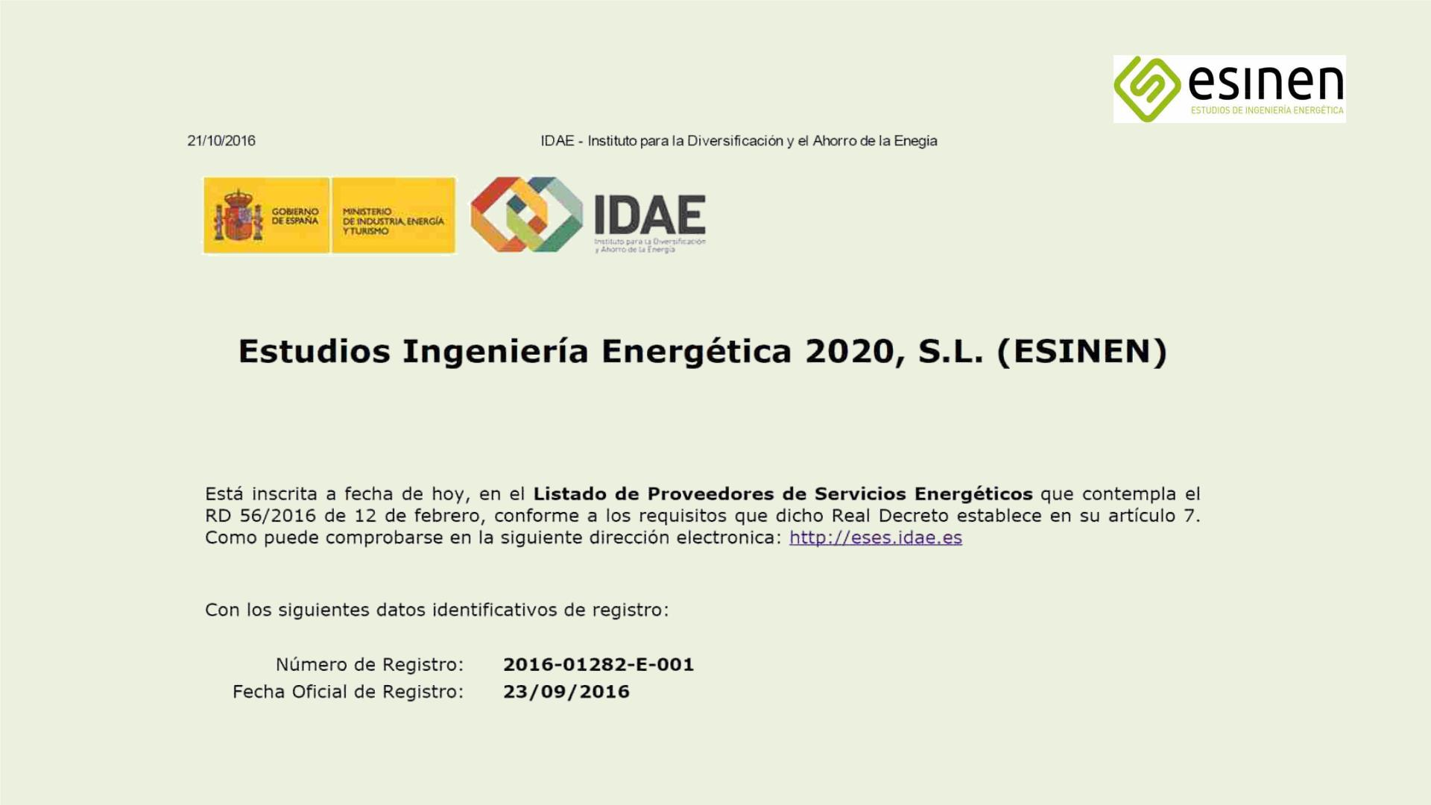
Official certification as an auditor

Slide 38

Certificate of registration with the Chamber of Commerce

Slide 39

New Address:
El Camín Real, 576
33199 Meres-Siero
Asturias, Spain
Engineering and consultancy services
Telephone numbers:
+34 985.50.98.23
+34 627.41.87.05
E-mails:
josecores@esinen-ingenieria.com
info@esinen-ingenieria.com

